Slide 1
Informatics 312
Enterprise Risk Management
Week 3

Slide 2
The Question
In November 2020, the Trump administration declared downloads of the Tik Tok and WeChat apps to be threats to national security and banned them both as of November 20, 2020.
The Biden administration has since reversed the order and is conducting its own "evidence-based" analysis of the potential security risks of using the apps.
What are the risks that the applications pose? Be specific.
Is there a way to mitigate the risks that each app poses?
Groups 1-4 Take Tik Tok;
Groups 5-7 Take WeChat.

Slide 3
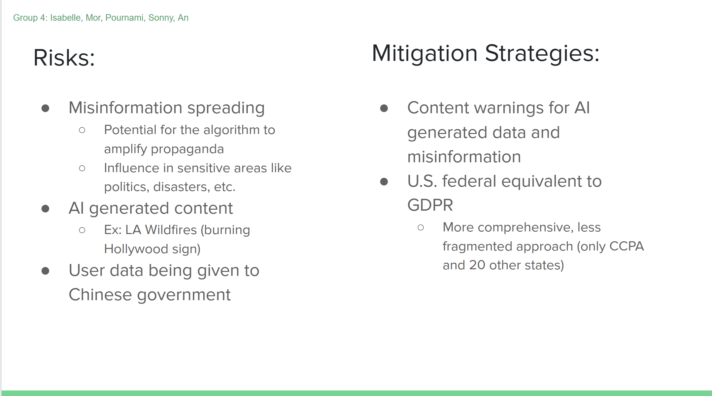

Slide 4
WeChat | INFO 312 | Group 5
Jasmine, Yacqub, Cam, Nebil

Slide 5
What are the risks that WeChat pose?
Security/Reputational Risk: Data Breach
Companies that use WeChat risks leaks of sensitive information.
Personal conversations can be leaked.
WeChat collects a large amount of user data which could be exploited for surveillance by third parties.
Impact: High - a data breach could expose vast amounts of personal data leading to identity theft, financial losses, and damage to reputation.
Likelihood: Moderate - while WeChat uses security measures, it is still vulnerable to cyber attacks.

Slide 6
What are the risks that WeChat pose?
Privacy/Informational Risks
Identity Theft
Vulnerability to phishing and scams
Compliance violations when used in other countries like the EU (GDPR)
Impact: High - Misuse of personal information.
Likelihood: High - The app collects large amounts of data which can be vulnerable to misuse.

Slide 7
Is there a way to mitigate the risks that WeChat poses?
Use of VPNs
Users can limit the quantity of personal information that WeChat gathers by limiting permissions.
Restrict access to non-essential data for functionality
Awareness training to users about phishing, scams, etc.
Avoid clicking suspicious links on the platform.
Avoid sharing sensitive information on WeChat.
Don’t use WeChat! Use end-to-end encrypted (method that prevents third parties from accessing data) messaging services like Signal or WhatsApp for sensitive discussions instead of WeChat.

Slide 8
WeChat Risk Analysis
Group Six: Jada Nguyen, Trevor Wong, Vinh Nguyen, Anjali Schatzer, Jocelyn Margarones

Slide 9
Risks
Censorship
Limiting free speech relating to political and social topics
Privacy
Data collection and sharing with Chinese Government
Misinformation and Disinformation Campaign
Spreading fake news
Relationship w/ Chinese Government
Where is data being collected going
Notes:
In March 2019, a researcher reportedly discovered a Chinese database containing billions of WeChat messages sent from users in not only China but also the United States, Taiwan, South Korea, and Australia.

Slide 10
“The Chinese government is employing tactics that seek to influence lawmakers and public opinion to achieve policies that are more favorable to China.”
FBI Security Assessment
Notes:
Censorship - WeChat imposes real-time automatic censorship of chat images through a mix of text recognition, visual recognition, and detection of detecting duplicate files
Mis/disinformation - As a social network, users can see posts from other users (real or fake) which may be used in a malicious manner.
Scam/fraud - Users are at risk of targeted attacks from bad actors through public posts and direct messaging.
Privacy -- WeChat gathers various sensitive information from its users such as network activity, location data, and browsing and search histories
Malware + Virus’s
Chinese surveillance policies so while external threats may be protected, governments can access private data
Criticized for censoring and blocking messages that discussed political information
Only share with third parties with consent of users
Privacy mode implememnted that limits data shared + collected

Slide 11
Data Minimization
Implemented Privacy Mode, transparency on data collection
Mitigations
Message Flagging
Warn users about potential mis/disinformation or fraudulent messages
Audits and Transparency
Identify security risks

Slide 12
Sources
https://www.forbes.com/sites/arthurherman/2023/02/03/wechat-chinas-other-trojan-horse/
https://www.leapxpert.com/exploring-the-wechat-and-whatsapp-compliance-landscape/
https://www.federalregister.gov/documents/2020/08/11/2020-17700/addressing-the-threat-posed-by-wechat-and-taking-additional-steps-to-address-the-national-emergency#:~:text=Like%20TikTok%2C%20WeChat%20automatically%20captures,Americans'%20personal%20and%20proprietary%20information.
https://2017-2021.commerce.gov/news/press-releases/2020/09/commerce-department-prohibits-wechat-and-tiktok-transactions-protect.html
https://www.digitalcrew.agency/is-wechat-safe-examining-the-security-features/

Slide 13
WeChat American Impact
WeChat has 1.48 million monthly active users in the US. 23% of US internet users in the 18–24 age group use WeChat.

Slide 14
Why Chinese Government is Flagged as Threat
‘‘The application captures the personal and proprietary information of Chinese nationals visiting the United States, thereby allowing the Chinese Communist Party a mechanism for keeping tabs on Chinese citizens who may be enjoying the benefits of a free society’
In March 2019, a researcher reportedly discovered a Chinese database containing billions of WeChat messages sent from users in not only China but also the United States, Taiwan, South Korea, and Australia.

Slide 15

WeChat Risk Analysis
Shaaz Charania, Evan Choi, Jake Ku, Tess Turner

Slide 16

Risks?
Automatically collects data from its users (Grey Rhino)
Gives Chinese Government access to Americans’ personal information
Location Data
Personal data getting leaked through various third party backdoors
Gives CCP access to Chinese nationals personal information who may be experiencing benefits of a free society for the first time in their lives
Automatic Censorship
WeChat began censoring content related to the LGBTQ+ community, leading to widespread criticism from activists and human rights organizations. (free speech)
Can spread disinformation campaigns benefitting CCP

Slide 17

Risk Mitigation
We Chat
1. Selling the company to a US Business
2. Create a “US” branch in order for US citizens to only get their data collected by the US branch
This will allow the data collection to stay only within the country
This will allow WeChat to continue operations in China
This data collection will not be allowed to be sold to third-parties
Users
Delete the App
Turn of location sharing
Limit access to photos and contacts
Avoid Suspicious Links and Files
Limit communicating sensitive information on app

Slide 18
Emerging Risk Topics: Digital Services Act (EU DSA)

Slide 19
What is content moderation?
"Content moderation" refers to the process of actively monitoring and managing user-generated content on online platforms to ensure it adheres to established community guidelines, legal requirements, and ethical standards, while "content integrity" signifies the accuracy, authenticity, and reliability of that content, meaning it is free from misinformation, manipulation, or other forms of distortion.

Slide 20
What is Integrity Risk Management?
Integrity risk management refers to a system within an organization that identifies, assesses, and mitigates risks related to ethical breaches, misconduct, fraud, corruption, and other actions that could compromise the organization's reputation and integrity, often focusing on upholding high ethical standards and compliance with regulations across all levels of the company; essentially, managing potential risks that could undermine the organization's trustworthiness and ethical conduct.

Slide 21
In Class Debate 1: Facebook and Cambridge Analytica

